Slide 1
2025 Bayesian Modelling Workshop
Seungjae Lee
Department of Civil & Mineral Engineering
University of Toronto
May 21, 2025

Slide 2
Workshop Outline
Measurement uncertainty and Bayesian estimation
Bayesian linear regression
Latent/unobservable variables
Advanced Topics: Design of Experiment and Optimization

Slide 3
Linear Regression

Slide 4
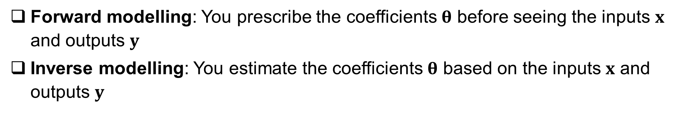
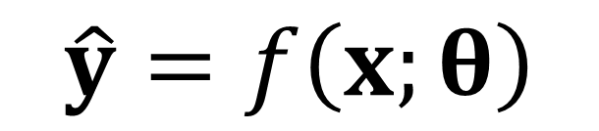
Forward vs Inverse Modelling
Functional form, Model structure/architecture
Inputs
Model coefficients
Predicted outputs
$$\hat{y}=f\left(x;θ\right)$$
Model
Forward modelling: You prescribe the coefficients $θ$ before seeing the inputs $x$ and outputs $y$
Inverse modelling: You estimate the coefficients $θ$ based on the inputs $x$ and outputs $y$

Slide 5
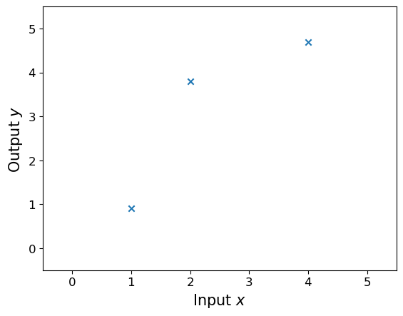
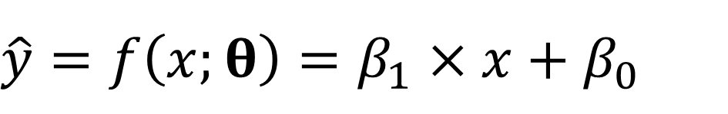
Linear Regression Review
$$\hat{y}=f\left(x;θ\right)=β_{1}×x+β_{0}$$

Slide 6
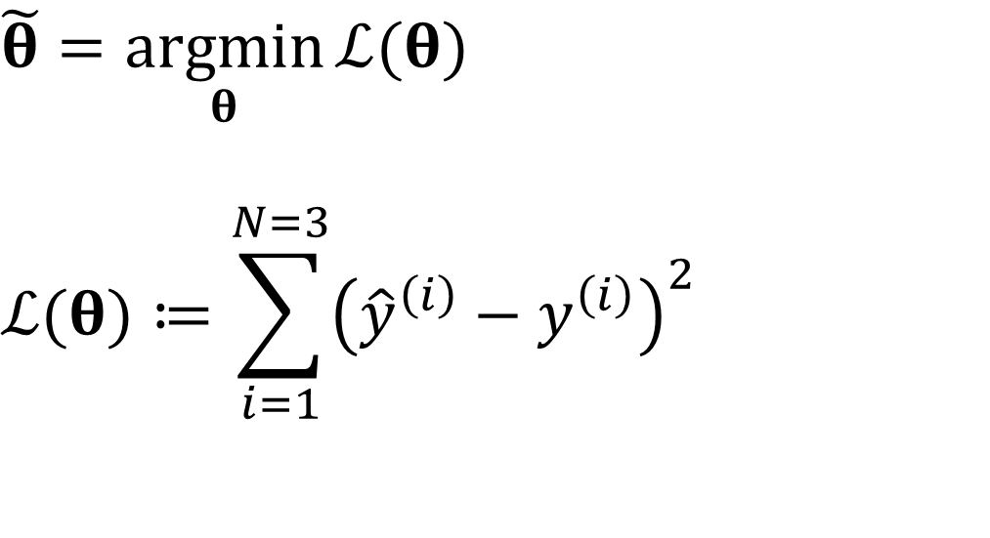
Linear Regression Review – Least Squares
$$\hat{y}=f\left(x;θ\right)=β_{1}×x+β_{0}$$
$$\tilde{θ}=\underset{θ}{argmin}{ℒ(θ)}$$
$$ℒ(θ)≔\sum_{i=1}^{N=3}{{\left({\hat{y}}^{\left(i\right)}−y^{\left(i\right)}\right)}^{2}}$$

Slide 7
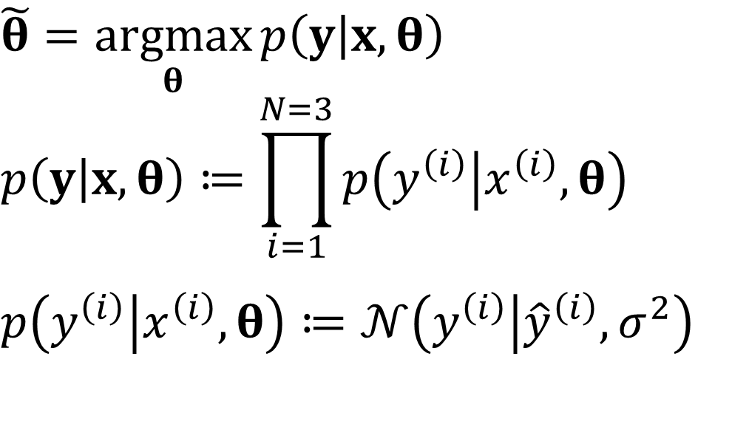
Linear Regression Review – Maximum Likelihood
$$\hat{y}=f\left(x;θ\right)=β_{1}×x+β_{0}$$
$$\tilde{θ}=\underset{θ}{argmax}{p\left(y | x,θ\right)}$$
$$p\left(y | x,θ\right)≔\prod_{i=1}^{N=3}{p\left(y^{\left(i\right)} | x^{\left(i\right)},θ\right)}$$
$$p\left(y^{\left(i\right)} | x^{\left(i\right)},θ\right)≔𝒩\left(y^{\left(i\right)} | {\hat{y}}^{\left(i\right)},σ^{2}\right)$$

Slide 8
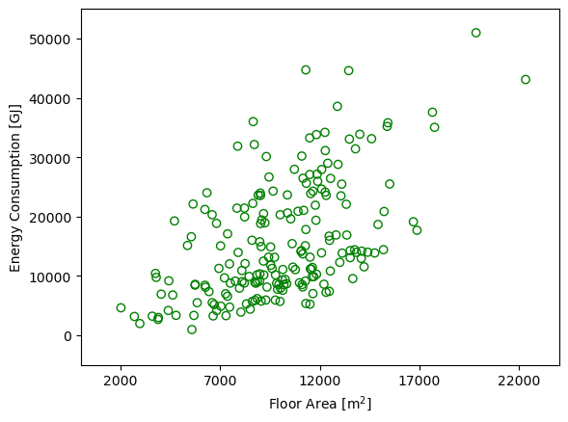
Linear Regression Review

Slide 9
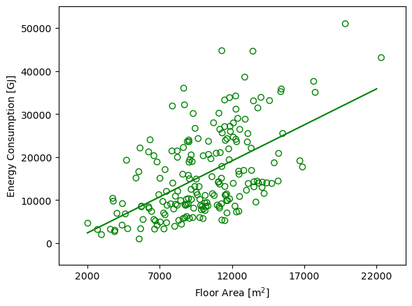
Linear Regression Review

Slide 10
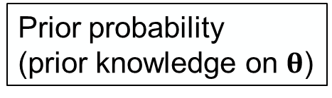
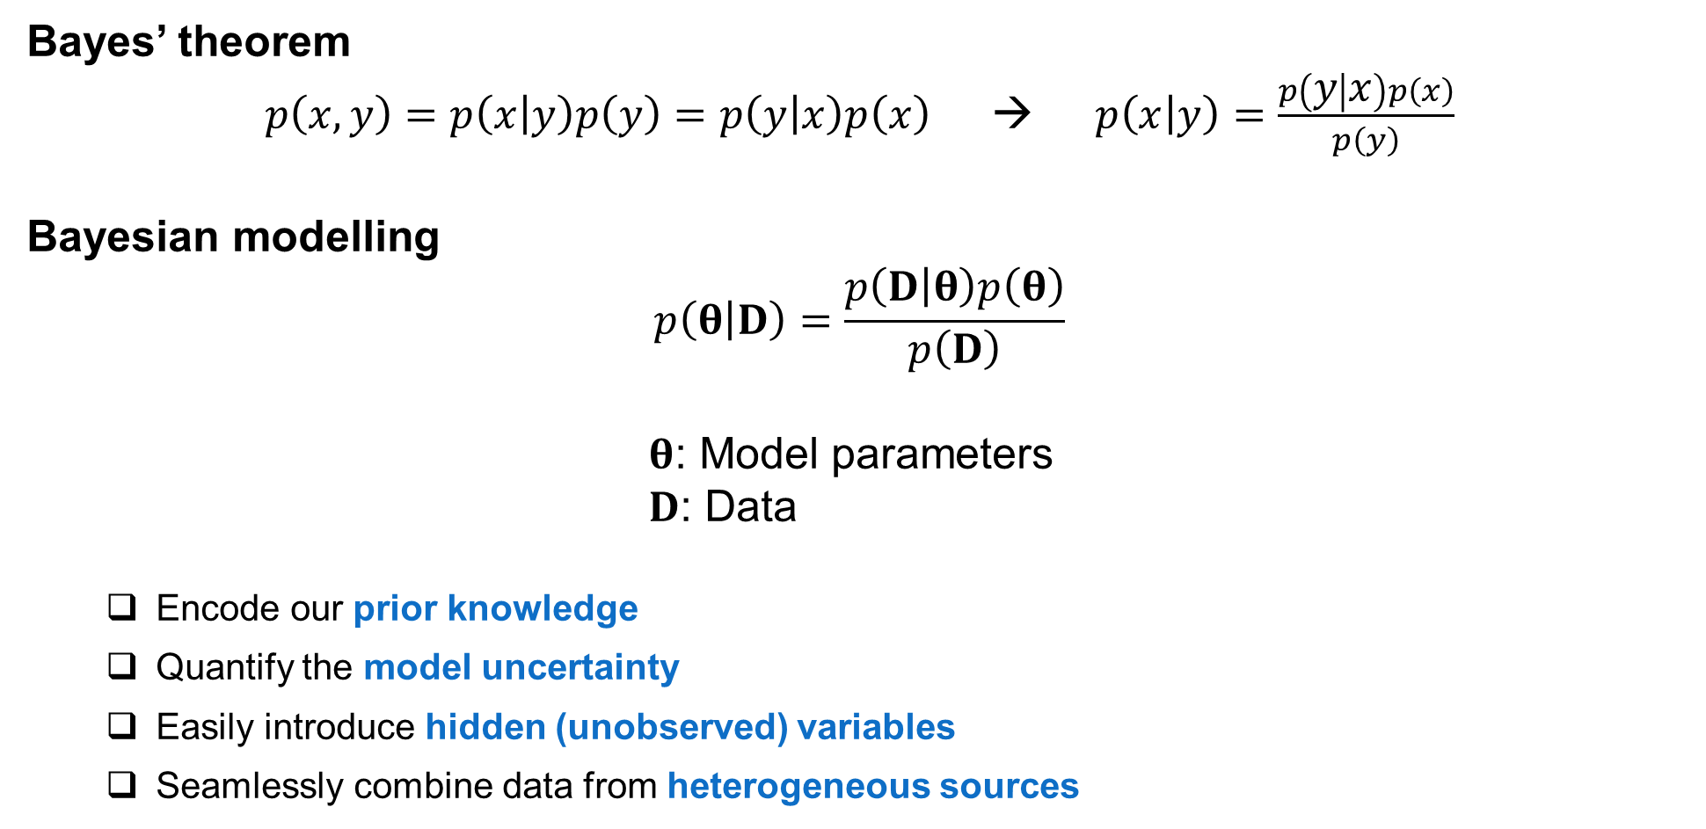
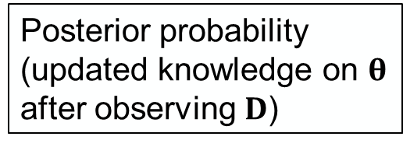
Bayesian Modelling
Bayes’ theorem
$p\left(x,y\right)=p\left(x | y\right)p\left(y\right)=p\left(y | x\right)p\left(x\right)$ → $p\left(x | y\right)=\frac{p\left(y | x\right)p\left(x\right)}{p\left(y\right)}$
Bayesian modelling
$$p\left(θ | D\right)=\frac{p\left(D | θ\right)p\left(θ\right)}{p\left(D\right)}$$
$θ$: Model parameters
$D$: Data
Encode our prior knowledge
Quantify the model uncertainty
Easily introduce hidden (unobserved) variables
Seamlessly combine data from heterogeneous sources
Likelihood
Prior probability
(prior knowledge on $θ$)
Posterior probability
(updated knowledge on $θ$ after observing $D$)
Flexible model structure

Slide 11
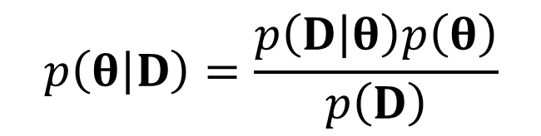
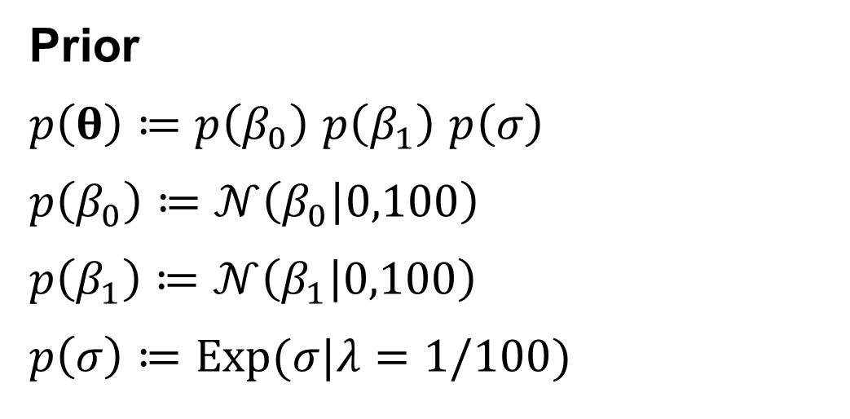
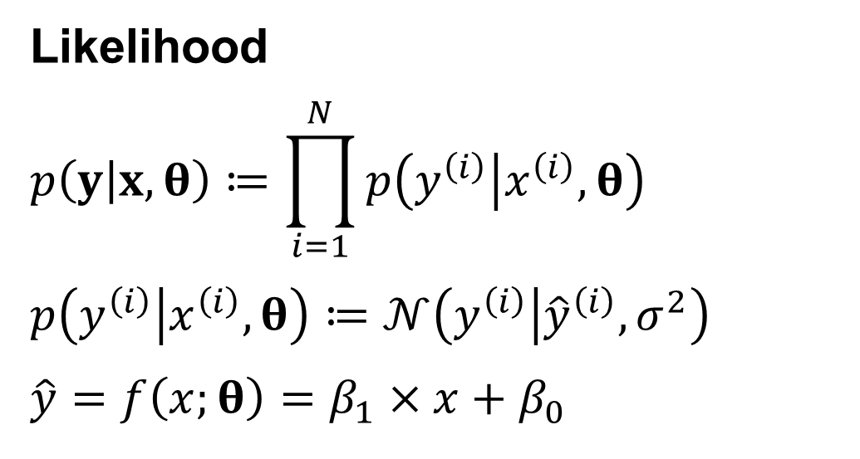


Bayesian Linear Regression
$$p\left(θ | D\right)=\frac{p\left(D | θ\right)p\left(θ\right)}{p\left(D\right)}$$
$$=\frac{p\left(D | θ\right)p\left(θ\right)}{\int{p\left(D | θ\right)p\left(θ\right)dθ}}$$
$$∝p\left(D | θ\right)p\left(θ\right)$$
Marginal likelihood (a.k.a., normalizing constant)
Prior
$p\left(θ\right)≔p\left(β_{0}\right)$ $p\left(β_{1}\right)$ $p\left(σ\right)$
$$p\left(β_{0}\right)≔𝒩\left(β_{0} | 0,100\right)$$
$$p\left(β_{1}\right)≔𝒩\left(β_{1} | 0,100\right)$$
$$p\left(σ\right)≔Exp(σ|λ=1/100)$$
Likelihood
$$p\left(y | x,θ\right)≔\prod_{i=1}^{N}{p\left(y^{\left(i\right)} | x^{\left(i\right)},θ\right)}$$
$$p\left(y^{\left(i\right)} | x^{\left(i\right)},θ\right)≔𝒩\left(y^{\left(i\right)} | {\hat{y}}^{\left(i\right)},σ^{2}\right)$$
$$\hat{y}=f\left(x;θ\right)=β_{1}×x+β_{0}$$

Slide 12
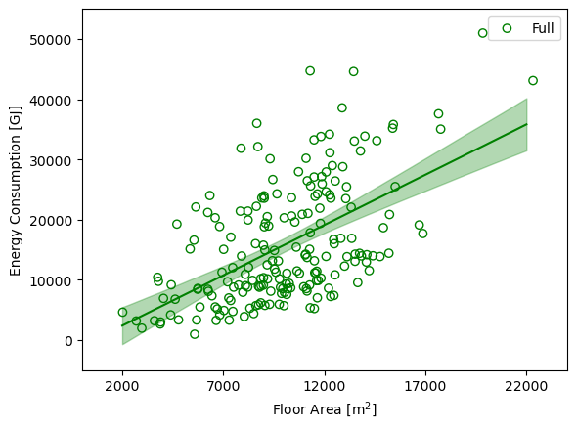
Bayesian Linear Regression
Least Squares (maximum-likelihood)
Bayesian

Slide 13
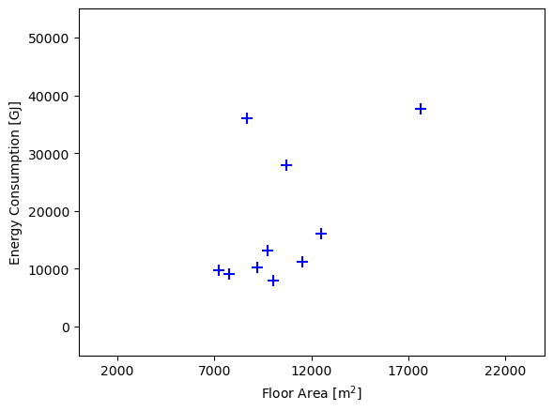
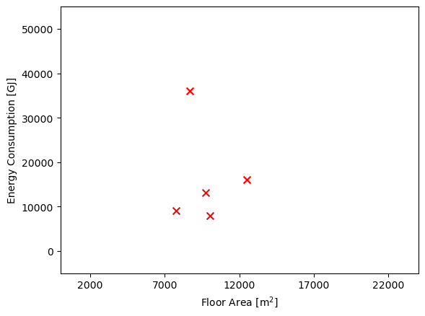
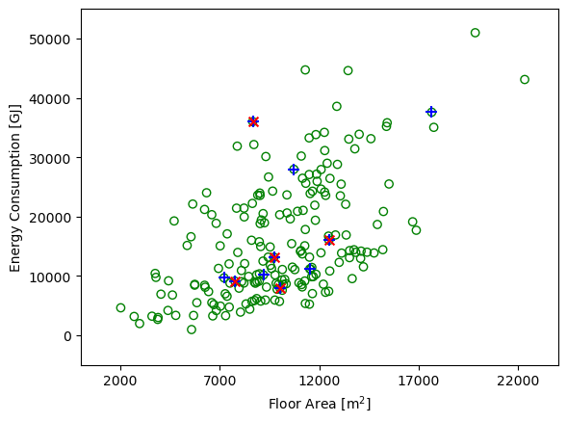
Bayesian Linear Regression
Full dataset
Subset
Subsubset

Slide 14
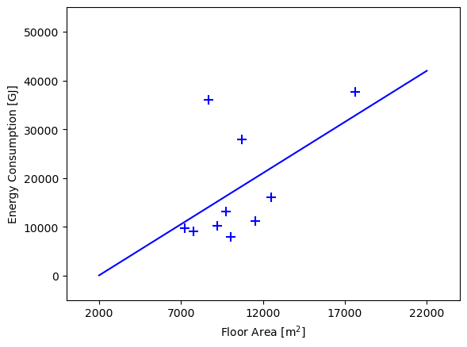
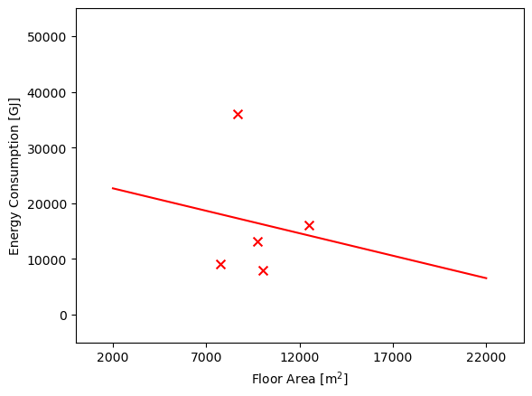
Bayesian Linear Regression
Full dataset
Subset
Subsubset

Slide 15
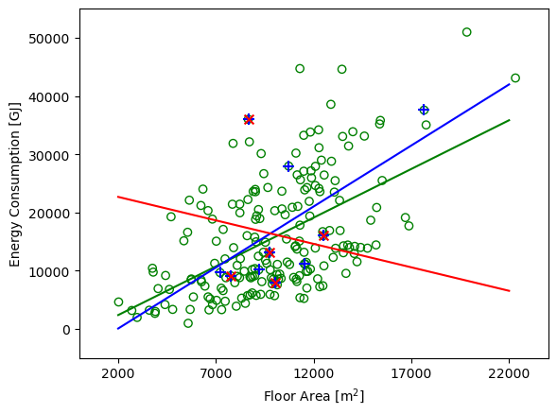
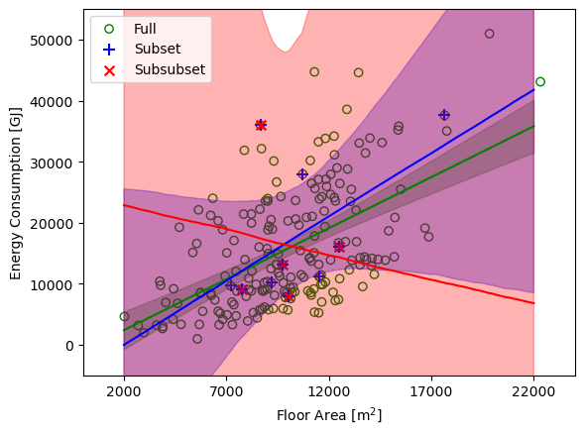
Bayesian Linear Regression
Least Squares (maximum-likelihood)
Bayesian

Slide 16
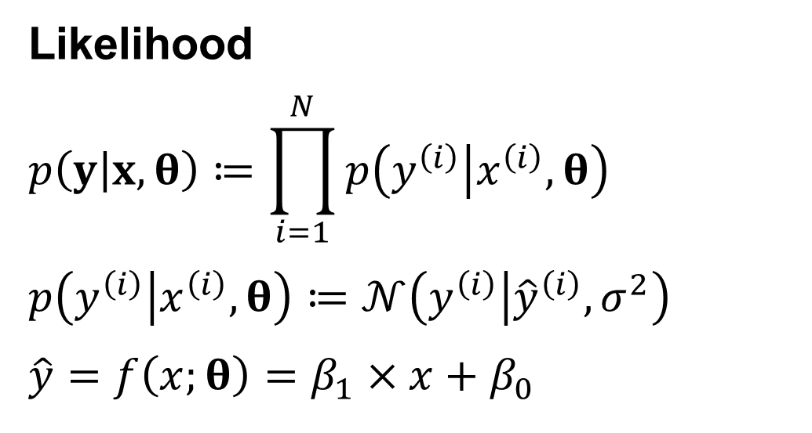
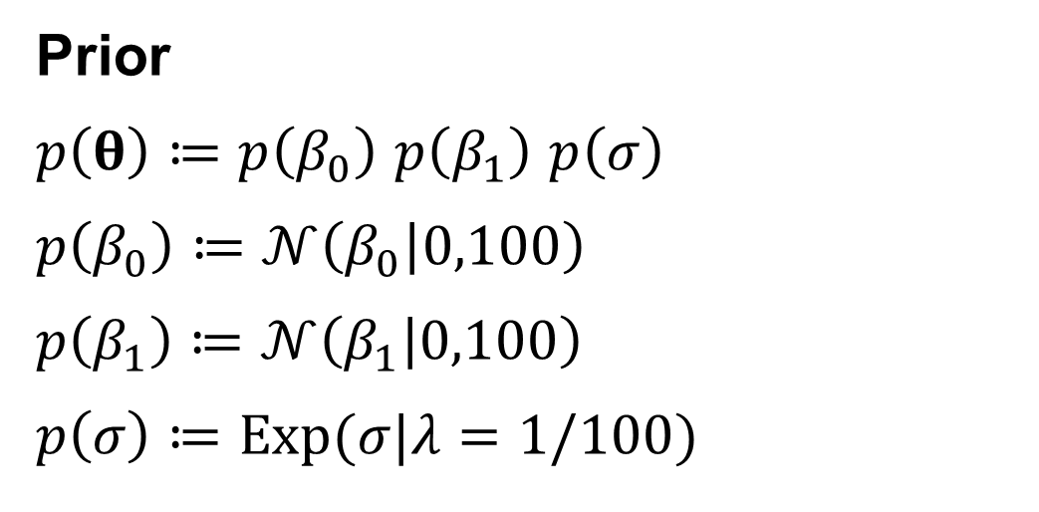
Bayesian Linear Regression
Prior
$p\left(θ\right)≔p\left(β_{0}\right)$ $p\left(β_{1}\right)$ $p\left(σ\right)$
$$p\left(β_{0}\right)≔𝒩\left(β_{0} | 0,100\right)$$
$$p\left(β_{1}\right)≔𝒩\left(β_{1} | 0,100\right)$$
$$p\left(σ\right)≔Exp(σ|λ=1/100)$$
Likelihood
$$p\left(y | x,θ\right)≔\prod_{i=1}^{N}{p\left(y^{\left(i\right)} | x^{\left(i\right)},θ\right)}$$
$$p\left(y^{\left(i\right)} | x^{\left(i\right)},θ\right)≔𝒩\left(y^{\left(i\right)} | {\hat{y}}^{\left(i\right)},σ^{2}\right)$$
$$\hat{y}=f\left(x;θ\right)=β_{1}×x+β_{0}$$

Slide 17
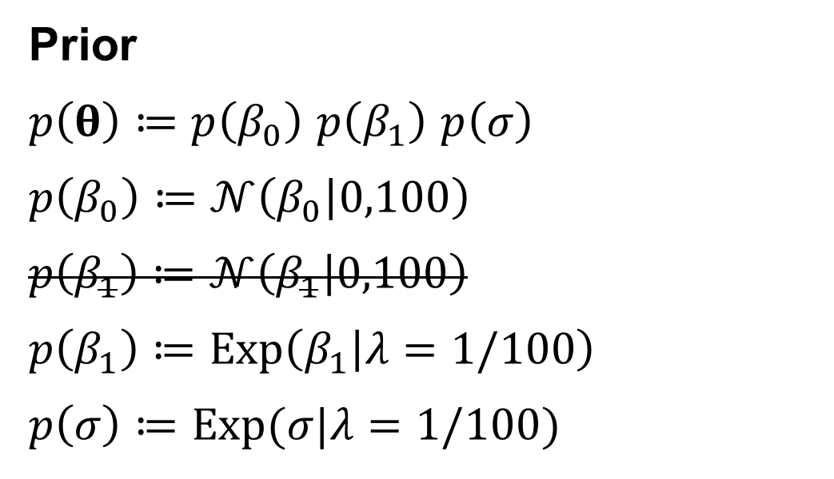
Bayesian Linear Regression
Prior
$p\left(θ\right)≔p\left(β_{0}\right)$ $p\left(β_{1}\right)$ $p\left(σ\right)$
$$p\left(β_{0}\right)≔𝒩\left(β_{0} | 0,100\right)$$
$$p\left(β_{1}\right)≔𝒩\left(β_{1} | 0,100\right)$$
$$p\left(β_{1}\right)≔Exp\left(β_{1} | λ=1/100\right)$$
$$p\left(σ\right)≔Exp(σ|λ=1/100)$$
Likelihood
$$p\left(y | x,θ\right)≔\prod_{i=1}^{N}{p\left(y^{\left(i\right)} | x^{\left(i\right)},θ\right)}$$
$$p\left(y^{\left(i\right)} | x^{\left(i\right)},θ\right)≔𝒩\left(y^{\left(i\right)} | {\hat{y}}^{\left(i\right)},σ^{2}\right)$$
$$\hat{y}=f\left(x;θ\right)=β_{1}×x+β_{0}$$

Slide 18
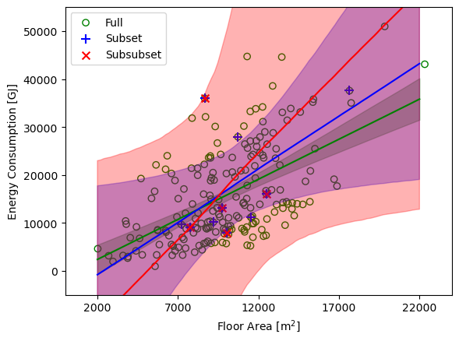
Bayesian Linear Regression
Bayesian
Without informative prior
Bayesian
With informative prior (positive correlation)

Slide 19
Exercise

Slide 20
Aleatoric VS. Epistemic Uncertainty
Aleatoric uncertainty is also known as stochastic (random) uncertainty, and is representative of unknowns that differ each time we run the same experiment.
Epistemic uncertainty is also known as systematic uncertainty, and is due to things one could in principle know but does not in practice. This may be because a measurement is not accurate, because the model neglects certain effects, or because particular data have been deliberately hidden.

Slide 21
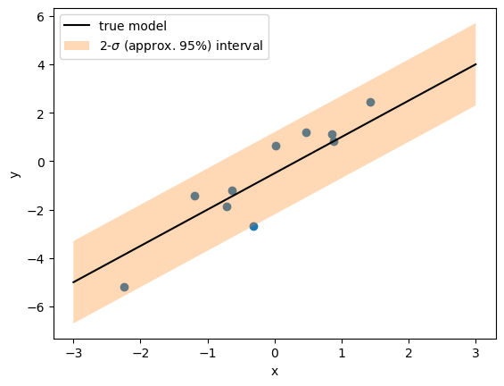
Aleatoric VS. Epistemic Uncertainty

Slide 22
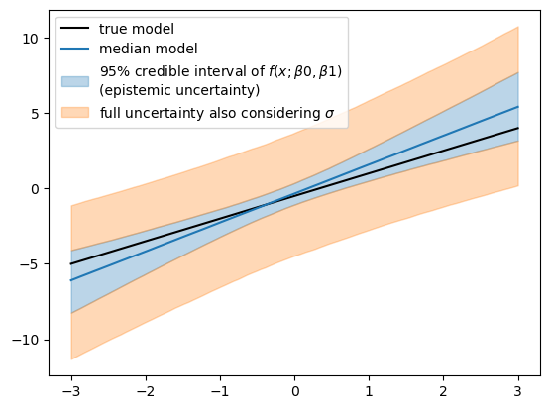
Aleatoric VS. Epistemic Uncertainty

Slide 23
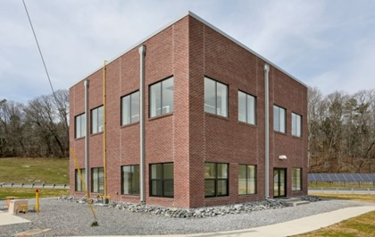
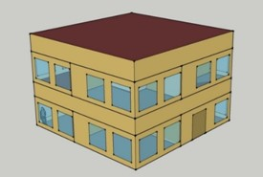
Bayesian Material Property Calibration/Estimation
Create datasets from the FRP for empirical validation of simulation tools, which has limited input uncertainty compared to real buildings.
Provide modeling Input document + operational data
Demonstrate with a detailed EnergyPlus model

Slide 24
Bayesian Material Property Calibration/Estimation
Temperature
Heat flux
Interior
Exterior
Gypsum
Batt Ins.
Concrete block
Air gap
Brick

Slide 25


Bayesian Estimation with 1-D Finite Difference Heat Conduction Model
Internal node heat diffusion equation
$$C_{p,i}ρ_{i}Δx\frac{dT_{i}}{dt}=\frac{k_{i}}{Δx}\left(T_{i+1}−2T_{i}+T_{i−1}\right)$$
discretization
Node temperatures
Boundary conditions
20 nodes (3 in gypsum, 6 in insulation, 10 in concrete block, 6 in face brick)
$x_{k+1}=A_{d}x_{k}+B_{d}u_{k}+w_{k}$
$y_{k}=C_{d}x_{k}+v_{k}$
$w_{k}\sim 𝒩\left(0,Q\right)$
$v_{k}\sim 𝒩\left(0,R\right)$
Process noise
Unconsidered factors influencing the dynamic
Model imperfection
Measurement noise

Slide 26
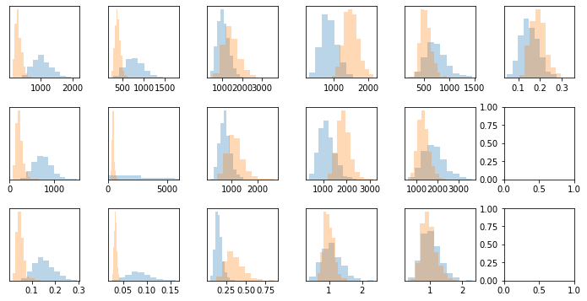
Bayesian Estimation with 1-D Finite Difference Heat Conduction Model
Gypsum
Batt
Gypsum
CMU
Face Brick
Cp
[J/kg-K]
Air R
[m2-K/W]
ρ
[kg/m3]
k
[W/m-K]
R-value computed with median values = 3.625 [m2-K/W]

Slide 27
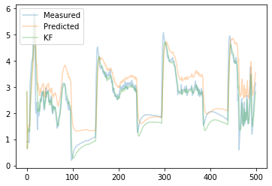
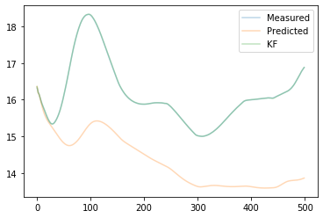
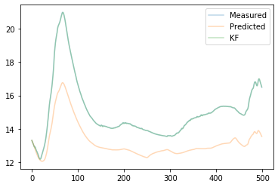
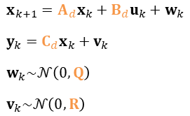
Bayesian Estimation with 1-D Finite Difference Heat Conduction Model
Node temperatures
Boundary conditions
1
2
3
$x_{k+1}=A_{d}x_{k}+B_{d}u_{k}+w_{k}$
$y_{k}=C_{d}x_{k}+v_{k}$
$w_{k}\sim 𝒩\left(0,Q\right)$
$v_{k}\sim 𝒩\left(0,R\right)$
Process noise
Unconsidered factors influencing the dynamic
Model imperfection
Measurement noise
1
2
3
Median values of the root of the diagonal components in the process noise covariance matrix: 0.00189 – 0.413
Median values of the root of the diagonal components in the Measurement noise covariance matrix: 0.408, 0.00712, 0.0124

Slide 28
“Sometimes classical statistics gives up. Bayes never gives up, so we’re under more responsibility to check our models.”
– Andrew Gelman

Slide 29
Thank you
Seungjae Lee
sjae.lee@utoronto.ca

Slide 30
Bayesian Linear Regression
Estimation/Training/Inference Methods
Analytical solution
Sampling (e.g., Markov chain Monte Carlo)
Variational inference

